Slide 1
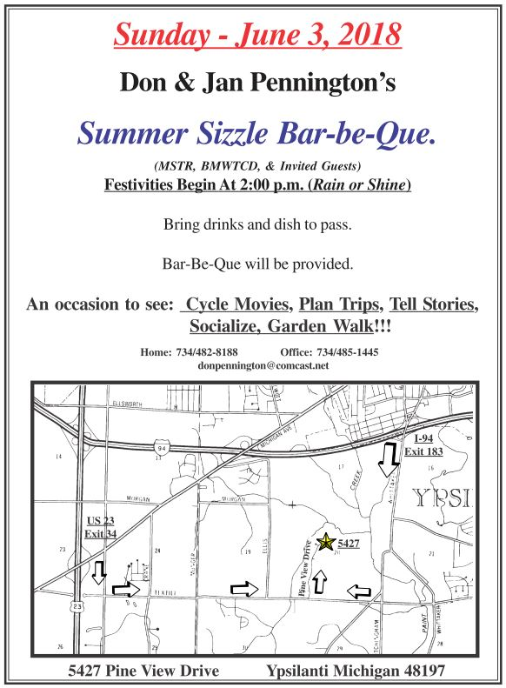
Sunday, June 2nd, 2024
Don: (734) 645-4961
Jan: (734) 645-4963

